Slide 1
LEAD SCORE CASE STUDY LOGISTIC REGRESSION
NAKUL JAIN

Slide 2
AGENDA
The purpose is to optimize the lead scoring mechanism based on their fit, demographics, behaviours, buying tendency etc. by implementing explicit and implicit lead scoring modelling with lead point system.

Slide 3
PROBLEM STATEMENT
X Education is an organisation that provides online course for industry professionals. On any given day, many professionals who are interested in the courses land on the website and browse for courses.
The company markets its courses on several popular search engines like google. Once these people land on the website, they might browse the courses or fill up a form for the course or watch some videos.
When these people fill up a form providing their email address or phone number, they are classified to be a lead.
Moreover, the company also gets leads through past referrals.

Slide 4
PROBLEM STATEMENT
Once these leads are acquired, employees from the sales teams start making calls, writing emails etc. through this process, some of the leads get converted whilst most do not.
The typical lead conversion rate of X education is around 30%.
Although the company generates a lot of leads only a few are converted into paying customers, wherein the company wants a higher lead conversion.
X Education wants to select its most promising leads also known as ‘hot leads’ that can be converted to paying customers.
If they successfully identify this set of leads, the lead conversion rate should go up as the sales team will now be focusing more on communicating with the potential leads rather than making calls to everyone.

Slide 5
BUSINESS GOAL
The company requires a logistic regression model to be built for selecting most promising leads.
Lead score to be given to each lead (0-100) such that it indicates how promising the lead could be. The higher the lead score the more promise of the lead to get converted; and lower it is lesser the chances of conversion.
The model to be built in the lead conversion rate around 80% or more.
There are some more problems presented by the company which your model should be able to adjust to if the company’s requirement changes in the future so you will need to handle these as well.

Slide 6
STRATERGY
Import data
Clean and prepare the acquired data for further analysis
Exploratory data analysis for figuring out most helpful attributes for conversion
Scaling features
Splitting the data into test and train dataset
Prepare the data for model building
Build a logistic regression model and a random forest model
Assign a lead score for each leads
Test the model on train set
Evaluate model by different measures or metrics- plot AUC curve to compare both models

Slide 7
DATA SOURCING, CLEANING & PREPRATION
Read the data from CSV file
Outlier treatment
Data cleaning- Handling null variables and removing higher null values data
Removing redundant columns in the data
Imputing null values
Exploratory data analysis- approx. conversion rate is 38%
Feature standardisation

Slide 8
OUTLIERS
Total visits, Total Time Spent on Website, Page Views Per Visit have outliers

Slide 9
DATA PREPRATION
Converted binary variables into 0 & 1
Created dummy variables for categorical variables

Slide 10
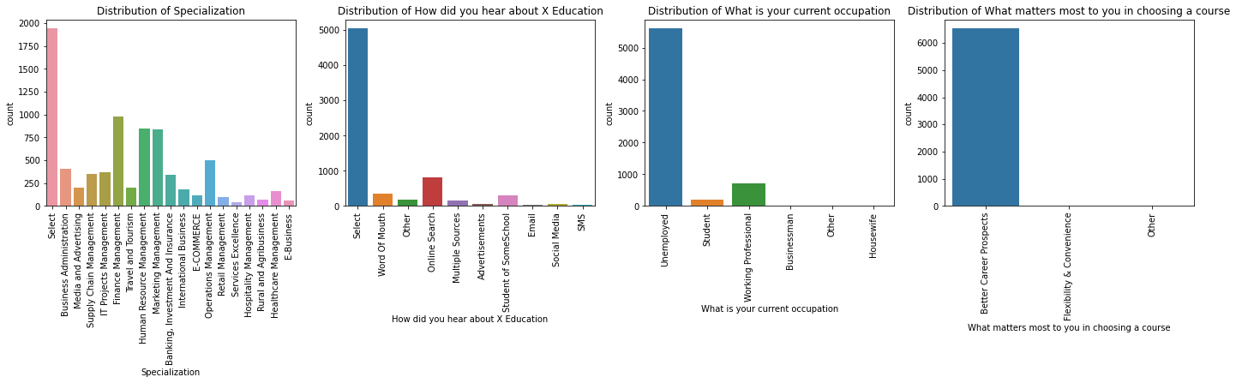
EXPLORATORY DATA ANALYSIS

Slide 11
MODEL BUILDING
Feature selection using RFE
Determined Optimal Model using Logistic regression
Plot AUC and compare Logistic regression and random forest models for better understanding

Slide 12
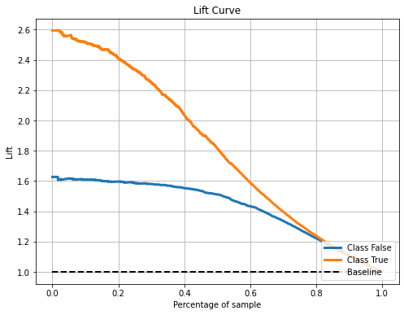
RESULTS
Baseline conversion rate: 38.54 % Lift equivalent to conversion rate of 80%: 2.08
The sales team's conversion rate must rise by a factor of 2.08 in order to obtain a conversion rate of 80%. The graph above shows that by contacting the top 35% of leads by lead scores, the sales team may achieve a conversion rate of 80%, presuming that our test set is a fair sample of future leads seen by X Education.

Slide 13
CONCLUSION
In conclusion, our created logistic regression model showed to be a more effective lead scoring model. It accurately gives a higher lead score to leads who will convert compared to leads who will not convert in almost 88% of the time. By concentrating on the top 30% of leads according to lead score, the sales force can use this lead scoring approach to raise their conversion rate to 80%.
It would be beneficial to establish a minimum lead score before sales representatives even consider contacting a lead as a suggested next step for X Education. This can be done after the price of paying a sales representative to contact a lead and the value of a lead that is converted have been calculated. Using a profit matrix, the optimal threshold for classification to maximize profit can be identified.

Slide 14
SUMMARY
There are a lot of leads generated in the initial stage (top) but only a few of them come out as paying customers in the bottom.
In the middle stage, you need to nurture the potential leads well, i.e. educating the lead about the product, constantly communicating etc; in order to get a higher lead conversion.
First, sort out the best prospects from the leads you have generated.
‘Total visits’ , ‘Total Time spent on Website’, Page views per Visit’ must contribute most towards the probability of a lead getting converted.
Then, you must keep a list of leads handy so that you can inform them about new courses, services, job offers and future higher studies.

Slide 15
SUMMARY
Monitor each lead carefully so that you can tailor the information you send them.
Carefully provide job offerings, information and courses that suits best according to the interest of the leads.
A proper plan to chart the needs of each lead will go a long way to capture the leads as prospects.
Focus on converted leads.
Hold question-answer sessions with leads to extract the right information you need about them.
Make further inquiries and appointments with the leads to determine their intention and mentality to join online courses.

Slide 16
THANK YOU

